Slide 1


ANALYSIS OF BANKING DATA USING PYSPARK

Slide 2

Techniques used
PySpark
Pandas
OneHotEncoderEstimator
StringIndexer
VectorAssembler
Pipeline
Logistic regression
Precision and recall
Decision Tree
Random Forest

Slide 3
OVERVIEW
Dataset is related to direct marketing campaigns (phone calls) of Portuguese.
PySpark is Used Majorly for Data Cleaning and data analysing.
Logistic Regression used for probability of discrete outcome.
Best Prediction with high accuracy rate.
Can be used in many other sectors where customers are present.
Can be improved even more with clean dataset.
Prediction can be varied on datasets.

Slide 4
PROJECT MOTIVATION
Best for organisations and customers.
Can be used in many sectors
Can reduce the project budget with good results

Slide 5
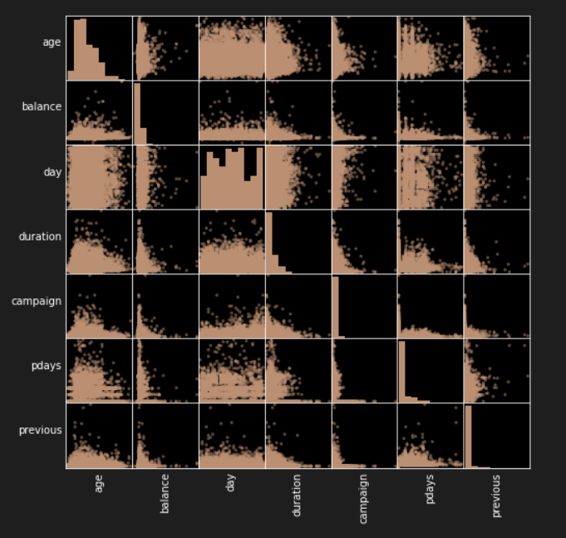
DATA DESCRIPTION

Slide 6
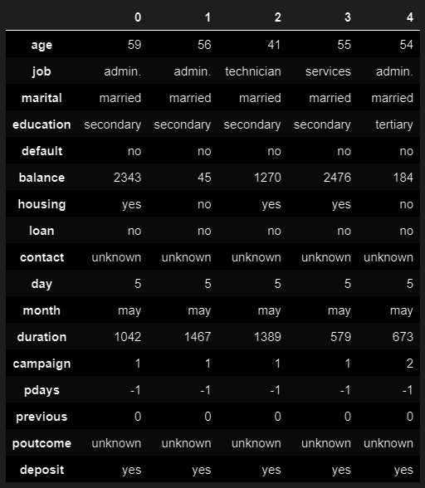
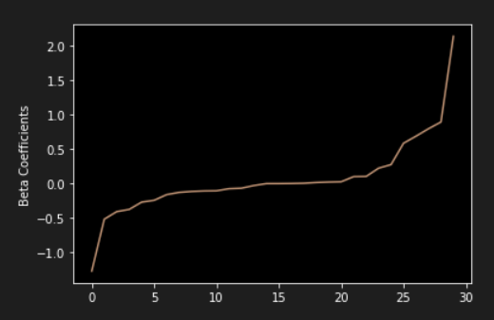
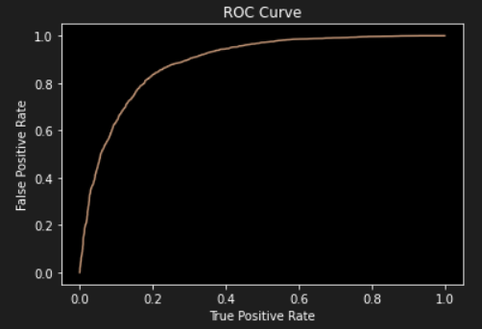

Slide 7
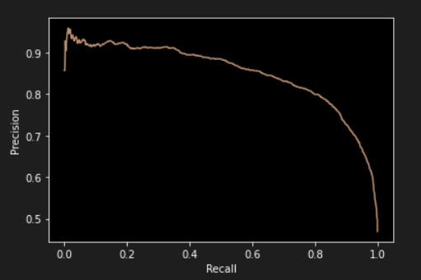
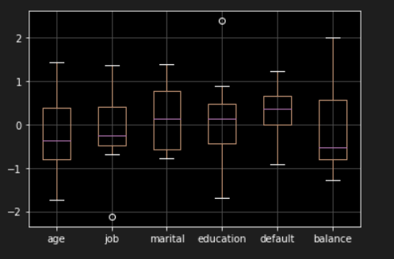
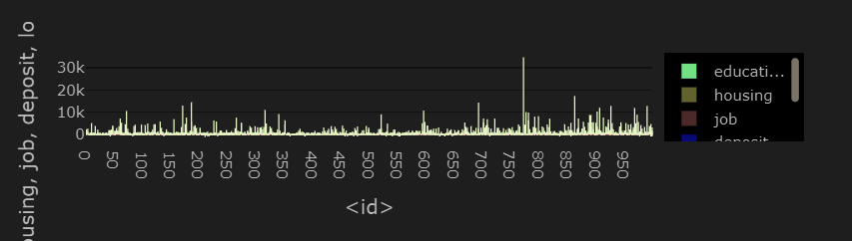

Slide 8
DATA ANALYTICS USED
LR model
Decision Tree classifier
Random forest Classifier
Gradient-Boosted Tree classifier.

Slide 9
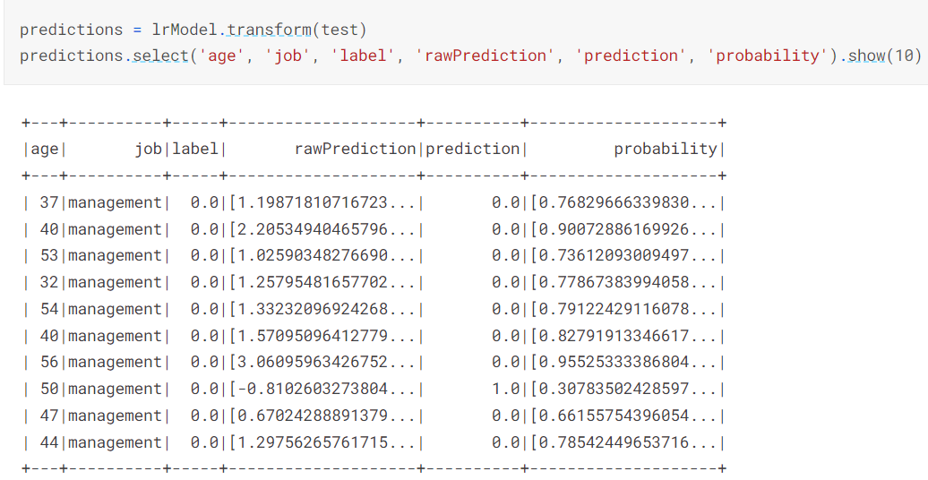
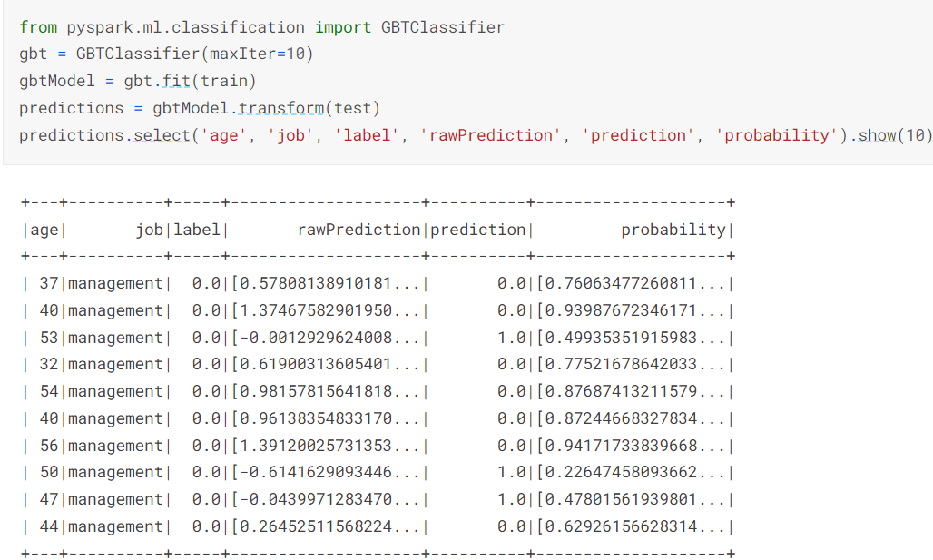

Slide 10
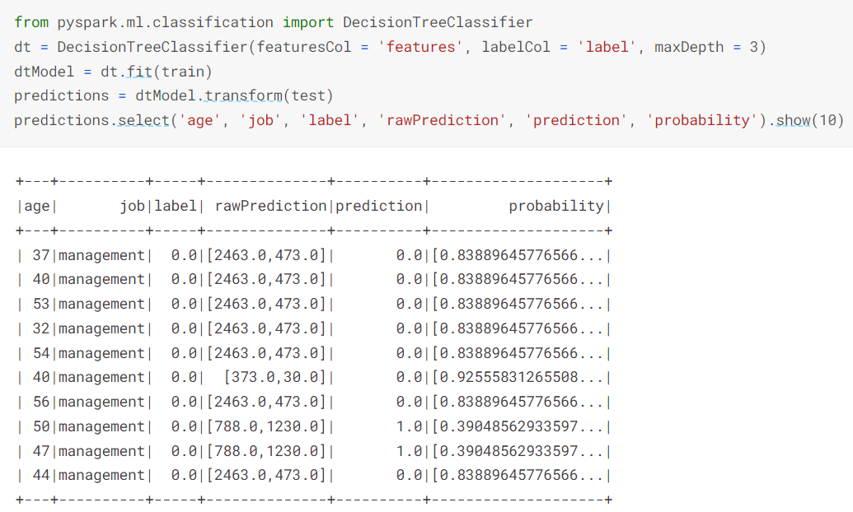
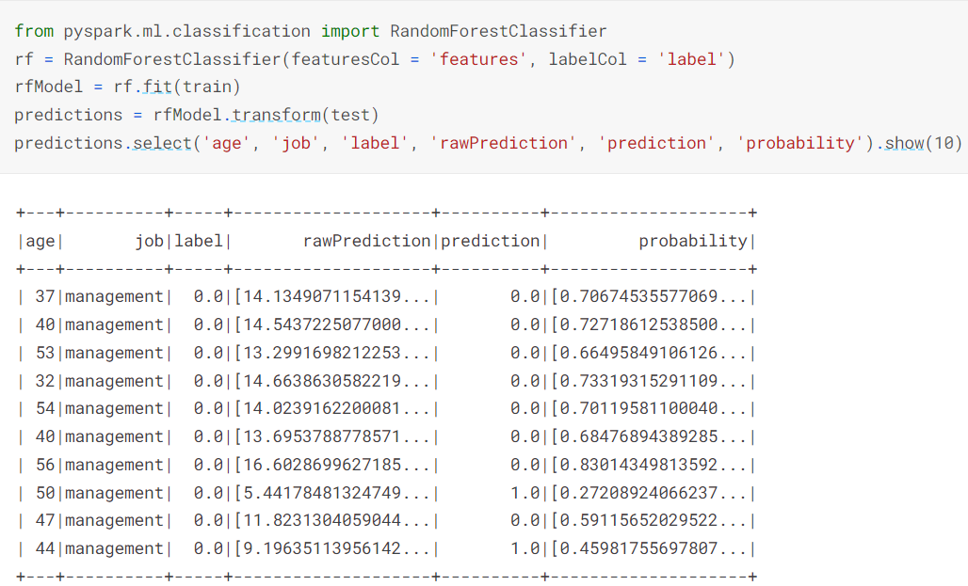

Slide 11
CONCLUSION
Python language with PySpark.
One of the best project with high predictions.
Can be used in many sectors.
Will benefit both organisations and customers.

